Slide 1
Indic Text Segmentation
Presented by :
Swaran Lata
Senior Director & HoD (TDIL Programme) Department of Electronics and Information Technology (DeitY)
E-mail: slata@deity.gov.in

Slide 2
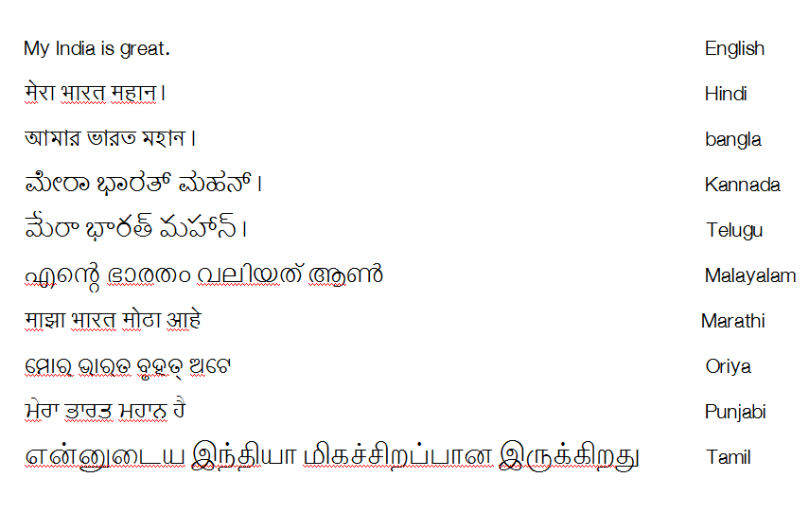
Diverse Multilinguality in India

Slide 3
Major Scripts and Corresponding Languages in India
Northern Scripts
(Gupta Scripts)
Unknown Ancient Scripts
Southern Scripts
Indus Script
(proto Brahmi Scripts)
?
2000 BC
Grantha
Tamil
Malayalam
8th Century
Brahmi Script
Kharoshthi Script 400 BC-300 BC
Pallava Granth
Southern Sinhalese
400 BC
Landa
Sharda
Sinhali Brahmi
Cental Sinhali
7th century
3rd BC
Brahmi Script (Ashokan)
Kutil
South-eastern Asian- Burmese, Thai, Cambodian, Indonesian, Malasiyan, vietbames, Philipines etc
Gurmukhi
Nagari
Gaur
8th Century
Jain Nagari
Nepali (Newari)
Gauri
Telugu
Oriya
Central Asian
12th Century
Kaithi
Devanagari
Bangla
Assamese
Tibetan
Kannadda
Maithali
10th Century
Gujarati
Meetei
Kole hat
13th Century
Vettashut
Ol-Chiki

Slide 4
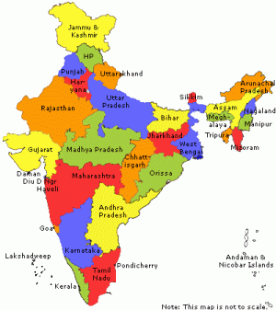
Hindi Speaking region covers 40% of India.
Any Localization effort Hindi is treated as test-bed.
The efforts are iterated for other Indian languages using language specific requirements for Indic languages

Slide 5
Indian language complexities
India has large linguistic diversity with 22 constitutionally recognized languages and 12 scripts
The mapping between languages and scripts is complex as multiple languages may have common scripts, and a language can be written in multiple scripts
Each language and script is unique in nature and cannot be easily replicated , even if they share common characteristics

Slide 6
Indic Text layout requirements
Proper Indic text segmentation
Indic text layout requirements
Horizontal and vertical arrangements of characters
Initial Letter styling on web & Digital publishing
Line breaking
Letter spacing

Slide 7
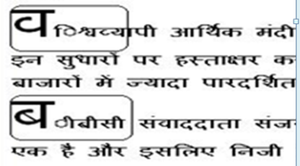
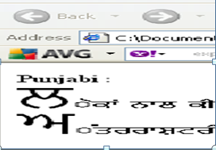
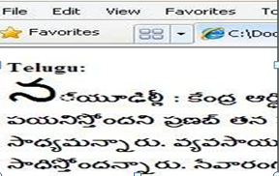
Challenges in Indian languages
Use case Scenarios: Initial letter styling on Web publishing

Slide 8
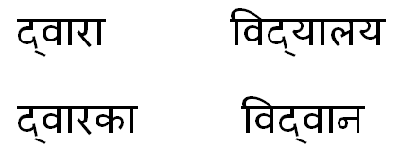
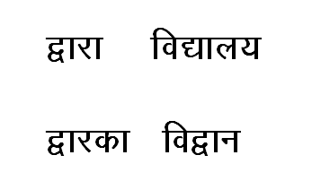
Challenges in Indian languages
Use case Scenarios: Text input in a word processor
Correct representation

Slide 9
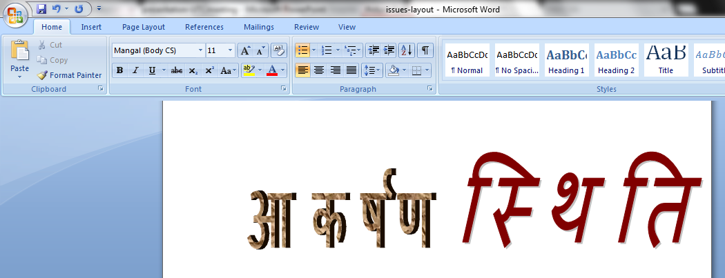
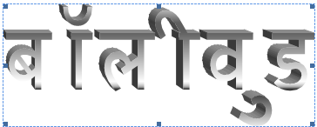
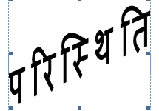
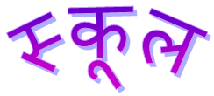
Challenges in Indian languages
Use case Scenarios: Formatting and spacing on
word art
Spacing
Change shape

Slide 10
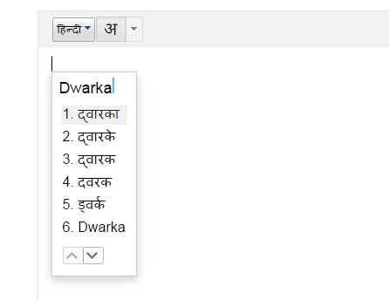
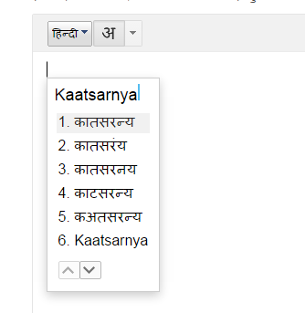
Challenges in Indian languages
Use case Scenarios: Phonetic Typing/Transliteration
कार्त्स्न्य

Slide 11
Challenges in Indian languages
Use case Scenarios : Letter spacing on Web browsers

Slide 12
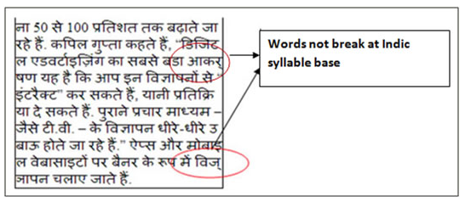
Challenges in Indian languages
Use case Scenarios: Line breaking on applying
word wrap
आकर्षण
विज्ञापन

Slide 13
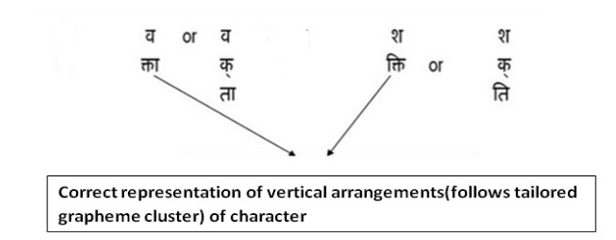
Challenges in Indian languages
Vertical arrangements of characters

Slide 14
Grapheme cluster boundaries defined in UAX#29
legacy grapheme cluster :
It is defined as a base followed by zero or more continuing characters.
Extended grapheme cluster
It is the same as a legacy grapheme cluster, with the addition of some other characters.
Tailored Grapheme cluster
Tailoring of Grapheme cluster to meet further requirements

Slide 15
Approach to be taken for Possible Solution
Due to high complexities of Indian languages , it is required to tailored the grapheme cluster for Indian languages
Indian languages Orthographic syllable should be based on tailored Grapheme Cluster as defined in UAX#29
Rules for wrapping of Indian languages characters and identification of syllable boundaries needs to be evolved for tailoring of grapheme cluster so that segmentation in Indian languages seems logically.

Slide 16
Indic Orthographic syllable
An Orthographic syllable includes Independent vowel or a base consonant and/or any combination of the following characters in the text stream:
Consonant/s and consonant + virama sequences
vowel signs
Modifiers
The above definition of Orthographic syllable is based on the tailored grapheme cluster discussed in section 3 of UAX#29 report.

Slide 17
Sample tailored Grapheme Cluster Boundaries for Indian languages
Examples of Indic Orthographic syllable based on tailored grapheme cluster boundaries
क्या | 0915 (क)DEVANAGARI LETTER KA 094D (्) DEVANAGARI SIGN VIRAMA 092F (य)DEVANAGARI LETTER SSA 093E (ा)DEVANAGARI SIGN AA | Devanagari kya
स्थि | 0938 (स)DEVANAGARI LETTER SA 094D (्)DEVANAGARI SIGN VIRAMA 0925 (थ)DEVANAGARI LETTER THA 091C (ि)DEVANAGARI LETTER I | Devanagari sthi
स्तः | 0938 (स) DEVANAGARI LETTER SA 0924 (त) DEVANAGARI LETTER TA 0903 (ः) DEVANAGARI Sign Visarga | Devanagari sth
त्क्ल | 0924 (त) DEVANAGARI LETTER TA 094D (्) DEVANAGARI SIGN VIRAMA 0915 (क) DEVANAGARI LETTER KA 094D (्) DEVANAGARI SIGN VIRAMA 0932 (ल) DEVANAGARI LETTER LA | Devanagari tkl

Slide 18
Improving Indic text segmentation....
Formulation of ABNF based Indic Orthographic syllable definition for defining rules
ABNF Valid Segmentation based Indic orthographic syllable definition is provided for correct and standardized representation of Indian languages text segmentation
Augmented Backus–Naur Form (ABNF) is a meta-language based on Backus–Naur Form (BNF), but consisting of its own syntax and derivation rules. The motive principle for ABNF is to describe a formal system of a language to be used as a bidirectional communications protocol.

Slide 19
Indic Orthographic syllable definition
V[m] | {CH}C[v][m] | CH
The linguistic definition of Indic orthographic syllable has been mapped to ABNF(Augmented Backus–Naur Form) for the purpose of text segmentation, line breaking , drop letter, letter spacing in horizontal text and vertical text representation.

Slide 20
Indic Orthographic syllable definition
Rule 1 : V[m]
Rule 2 : {CH}C[v][m]
Rule 3 : CH (This rule is applicable only at the end of the word)
V(upper case) is independent vowel
m is modifier(Anusvara/Visarga/Chandrabindu)
C is a consonant which may or may not include a single nukta
v (lower case) is any dependent vowel or vowel sign [Vvs has been used as symbol in Unicode for dependent vowel of full vowel V e.g AA_{vs}]
H is Virama/ halant
| is a rule separator
[ ] - The enclosed items is optional under this bracket
{} - The enclosed item/items occurs zero or repeated multiple times

Slide 21
Indic syllable boundary determination
No break rules for Indian languages
Rules | Do not break between
V[m] | Independent vowel and Modifier
{CH}C[v][m] | one or more consonant(N) + virama sequences and Consonant zero or more consonant(N) + virama sequences , Consonant and dependent vowel sign zero or more consonant(N) + virama sequences , Consonant and modifier zero or more consonant(N) + virama sequences, Consonant ,dependent vowel sign and modifier
CH | Consonant(N) with virama (applicable only for those Indian languages where pure consonant appears at the end of the word)
Note : Consonant may or may not include Nukta(N)

Slide 22
Categories values of Indic Orthographic syllable
The precise list of characters with their Unicode code points of all the categories i.e C, H, V etc defined in Indic syllable definition are enclosed as appendix 1 on the following link :
http://www.unicode.org/L2/L2016/16161-indic-text-seg.pdf

Slide 23
Boundary determination for line breaking
In Indic writing system , it is preferred that line breaks at word boundaries ,if required following principle may be adhered : New line cannot begin with following symbols/Punctuation marks. Also these should be retain with the associated text :
Symbols | Character name | Unicode code-point
। | DEVANAGARI DANDA | U + 0964
॥ | DEVANAGARI DOUBLE DANDA | U + 0965
) | RIGHT PARENTHESIS | U + 0029
+ | PLUS SIGN | U + 002B
* | ASTERISK | U + 002A
- | HYPHENATIONPOINT-VISIBLE HYPHEN HYPHENATION-SOFT HYPHEN | U + 2027 U+ 00AD
/ | SOLIDUS | U + 002F
, | COMMA | U + 002C
. | FULL STOP | U + 002E
: | COLON | U + 003A
; | SEMICOLON | U + 003B
= | EQUALS SIGN | U + 003D
> | GREATER-THAN SIGN | U + 003E
] | RIGHT SQUARE BRACKET | U + 005D
_ | LOW LINE | U + 005F
| | VERTICAL LINE | U + 007C
} | RIGHT CURLY BRACKET | U + 007D
~ | TILDE | U + 007E
% | PERCENT SIGN | U + 0025

Slide 24
Hyphenation at line boundary
The definition of Indic orthographic syllable may be used to break the line and a hyphen should be at the breaking point so that word can be read intuitively.
However the language specific morpho-phonemic rules and industry practices (from media, publishing and grammar books) could be used for hyphenation. U+ 00AD (soft hyphen) is used in some languages such as Tamil and Malayalam.
The hyphenated words can be broken at the hyphenation point (U + 2027) e.g.:
नर-नारी should be treated as:
नर- on the first line and नारी on the next line

Slide 25
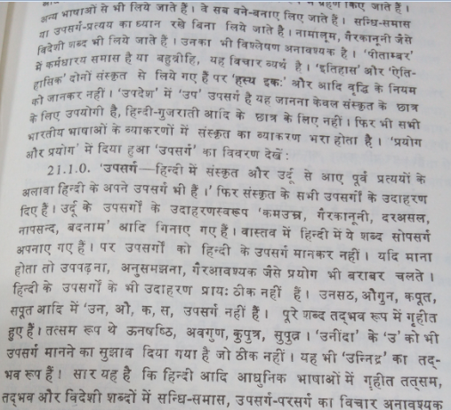
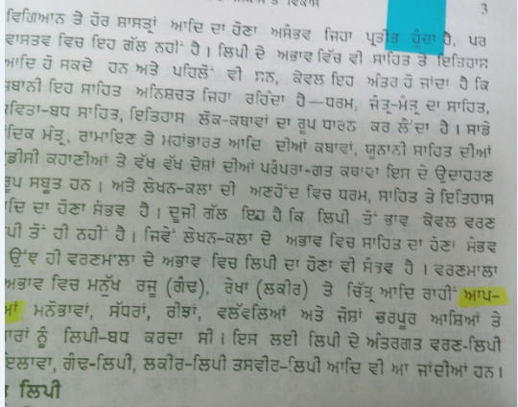
Hyphenation used in printed documents
Hindi
Punjabi

Slide 26
Word-break at line boundary in south Indian language
Malayalam

Slide 27
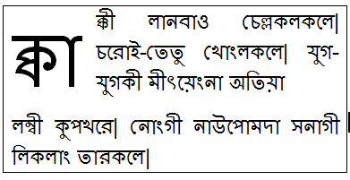
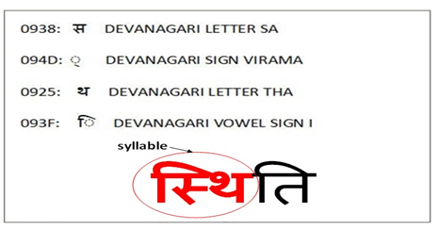
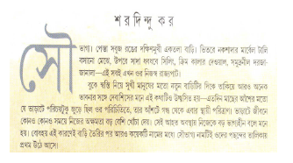
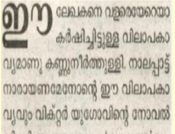
Indic text segmentation results based on Indic syllable definition

Slide 28
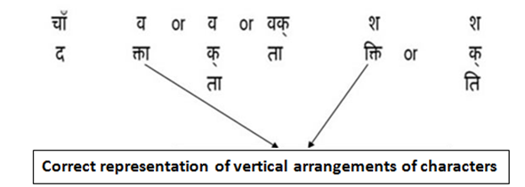
Indic text segmentation results based on Indic syllable definition

Slide 29
Proposal to incorporate Indian languages requirements in UAX#29
It is proposed to incorporate following Indian languages text segmentation requirements in UAX#29
Additional information on Indic orthographic syllable boundaries based on tailored grapheme cluster define in UAX#29
ABNF valid segmentation definition to define Indian languages orthographic syllable
No break rules for determination of Indic syllable boundary
Information for identification of boundaries of first letter styling, Guiding principles of line breaking at syllable level for Indian languages.
Detailed report at L2/16-161

Slide 30
Thanks

