Slide 1

Bridging Languages in ICU4X
How Diplomat brings i18n to the Web and Beyond

Slide 2

Who am I?
Tyler Knowlton
  B.S. Computer Science: Game Design
  Pursuing M.S. in Scientific Computing and Applied Mathematics
Google Summer of Code Contributor
  ~500 hours contributing to Diplomat
Talking to YOU about Diplomat

Slide 3
Sample Problem
Imagine a library with a large scope

Slide 4
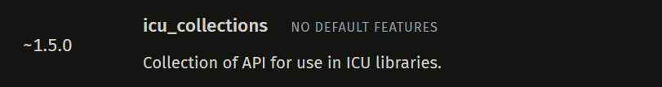
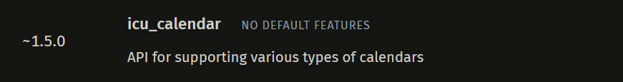
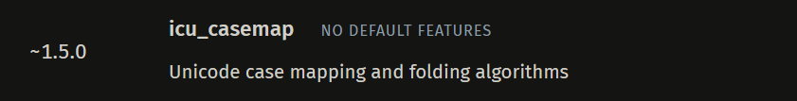
Sample Problem
Imagine a library with a large scope

Slide 5
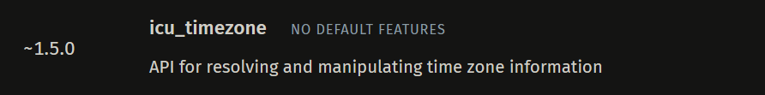
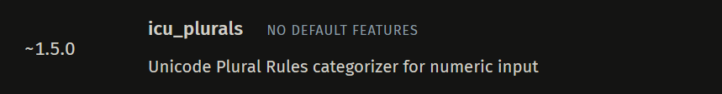

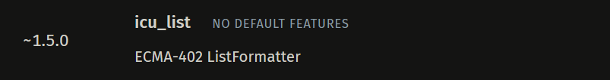
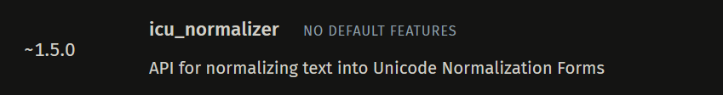
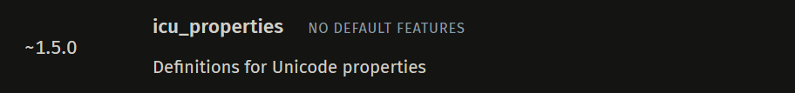
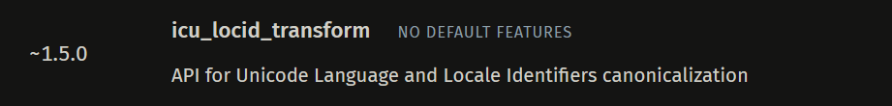
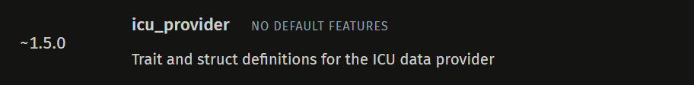
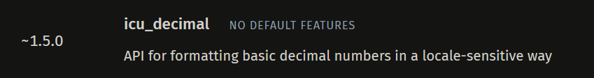
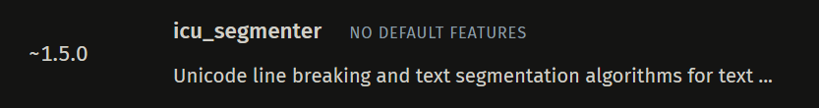
Sample Problem
Imagine a library with a large scope.
It segments text! It formats times!
Associated cost: portability.

Slide 6
ICU4X
Library of smaller libraries, all in Rust
Scale creates portability problem

Slide 7
Portability
C (or Rust) provides a simple option: FFI bindings
Another cost: ABI binding generation
#[no_mangle]
pub extern fn "C" foo() {
println!("Hello world!");
}
#include "<lib/external_def.h>"
int main() {
foo();
}

Slide 8




Challenges with ABIs: Bindings
const fs = require('node:fs');
const wasmRead = fs.readFileSync("./target/wasm32-unknown-unknown/debug/testlib.wasm");
function addition(wasmModule, a, b) {
return wasmModule.addition(a, b);
}
WebAssembly.instantiate(wasmRead).then(
(wasmModule) => {
console.log(addition(wasmModule.instance.exports, 1, 10000));
}
);
#[no_mangle]
pub extern "C" fn addition(a : i8, b : i8) -> i8 {
a + b
}
#include <stdint.h>
#include <stdio.h>
extern "C" int8_t addition(int8_t a, int8_t b);
int main() {
printf("%i\n", addition(1, 5));
return 0;
}
package dev.diplomattest.somelib;
import com.sun.jna.Callback
import com.sun.jna.Library
import com.sun.jna.Native
import com.sun.jna.Structure
internal interface TestLib: Library {
fun addition(a : Byte, b: Byte) : Byte
}
class TestLibrary {
companion object {
internal var libClass : TestLib::class.java
internal val lib: TestLib = Native.load("testlib", libClass)
fun add(a : Byte, b: Byte) : Byte {
return lib.addition(a, b)
}
}
}
fun main() {
println(TestLibrary.add(0, 10))
}
@meta.RecordUse()
@ffi.Native<ffi.Int8 Function(ffi.Int8, ffi.Int8)>(isLeaf: true, symbol: 'addition')
external int _icu4x_FixedDecimal_new_mv1(int a, int b);
final class TestLib implements ffi.Finalizable {
static int addition(int a, int b) {
return addition(a, b);
}
}
void main() {
print(TestLib.addition(0, 10));
}

Slide 9
Challenges with ABIs: ABI Quirks
#[repr(C)]
pub struct ReturnStruct {
i : i32,
j : i32,
k : i32
}
#[no_mangle]
pub extern "C" fn get_struct() -> ReturnStruct {
ReturnStruct { i: 42, j: 1, k: 102 }
}
struct ReturnStruct {
int32_t i;
int32_t j;
int32_t k;
};
struct ReturnStruct get_struct();

Slide 10
Challenges with ABIs: ABI Quirks
class ReturnStruct {
constructor(i, j, k) {
this.i = i; this.j = j; this.k = k;
}
}
function getStruct(wasmModule) {
const structBuffer = new DataView(wasmModule.memory.buffer, 0, 12);
wasmModule.get_struct(structBuffer);
let i = structBuffer.getInt32(0, true);
let j = structBuffer.getInt32(4, true);
let k = structBuffer.getInt32(8, true);
return new ReturnStruct(i, j, k);
}

Slide 11
Bindgen Tools
Why not use a tool for wrapping? cxx, emscripten, wasm-bindgen, etc.
Each works for one language
Dependencies (and work) stacks with more languages
#[cxx::bridge]
mod ffi {
...
}
#[wasm_bindgen]
pub fn some_function(...) {
...
}

Slide 12
Diplomat!
Translate to many languages
Design goals:
ONE source of truth
Extensible by language
Bindings AND definitions
Notes:
Used in ICU4X
Diplomat’s ultimate goal: translate to as many languages as possible. What design principles lead to this goal?

Slide 13

One Source of Truth: The Bridge
#[diplomat::bridge]
#[diplomat::bridge]
mod ffi {
pub struct SomeNamespace;
impl SomeNamespace {
pub fn do_a_thing() {
println!("doing thing");
}
}
}
Notes:
Simple explanation of the bridge

Slide 14
One Source of Truth: The Bridge
#[diplomat::bridge]
#[diplomat::bridge]
mod ffi {
#[diplomat::opaque]
#[diplomat::rust_link(icu::fixed_decimal::FixedDecimal, Struct)]
pub struct FixedDecimal(pub icu::fixed_decimal::FixedDecimal);
impl FixedDecimal {
#[diplomat::attr(auto, constructor)]
pub fn new(v: i32) -> Box<FixedDecimal> {
Box::new(FixedDecimal(icu::fixed_decimal::FixedDecimal::from(v)))
}
}
}
Notes:
Walkthrough: what is the bridge doing here? Link it to what it allows Diplomat to do as a result.

Slide 15

Extensible: Diplomat Backends
#[diplomat::bridge]
Bindings
@ffi.Native<ffi.Pointer<ffi.Opaque> Function(ffi.Int32)>(isLeaf: true, symbol: 'icu4x_FixedDecimal_new_mv1')
external ffi.Pointer<ffi.Opaque> _icu4x_FixedDecimal_new_mv1(int v);
(func $icu4x_FixedDecimal_new_mv1 (param i32) (result i32))
typedef struct FixedDecimal FixedDecimal;
FixedDecimal* icu4x_FixedDecimal_new_mv1(int32_t v);
internal interface FixedDecimalLib: Library {
fun icu4x_FixedDecimal_new_mv1(v: Int): Pointer
}

Slide 16
Bindings AND Definitions
#[diplomat::bridge]
Bindings
export class FixedDecimal {
#ptr = null;
constructor() {
this.#ptr = wasm.icu4x_FixedDecimal_new_mv1(v);
}
}
final class FixedDecimal implements ffi.Finalizable {
final ffi.Pointer<ffi.Opaque> _ffi;
FixedDecimal._fromFfi(this._ffi);
factory FixedDecimal(int v) {
final result = _icu4x_FixedDecimal_new_mv1(v);
return FixedDecimal._fromFfi(result);
}
}
class FixedDecimal {
public:
inline static std::unique_ptr<FixedDecimal> new_(int32_t v) {
auto result = icu4x_FixedDecimal_new_mv1(v);
return std::unique_ptr<FixedDecimal>(result);
}
}
class FixedDecimal internal constructor(internal val handle: Pointer) {
companion object {
fun new_(v: Int): FixedDecimal {
return FixedDecimal(lib.icu4x_FixedDecimal_new_mv1(v))
}
}
}

Slide 17
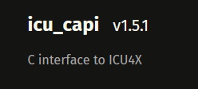
Results for ICU4X
ICU4X requires only one definition crate:
Immediate support for ALL of Diplomat’s supported languages
Minimal tweaking, some minor maintenance (as ICU4X changes and Diplomat is still in development)
Plus…

Slide 18

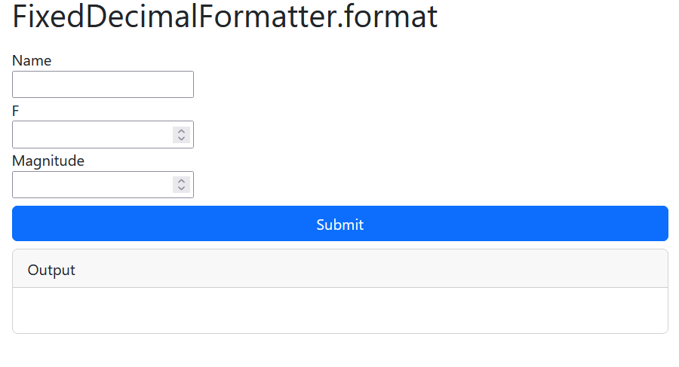
ICU4X on the Web!
Live Demo: https://unicode-org.github.io/icu4x/wasm-demo/

Slide 19
Google Summer of Code!
#[diplomat::bridge]
Bindings
???

Slide 20
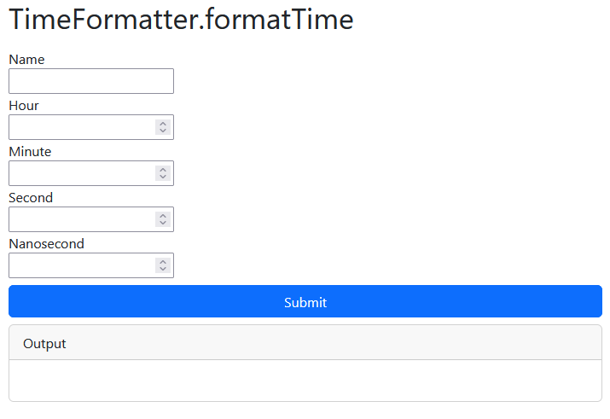
Diplomat and the Web (demo_gen)
pub fn format_time(&self, value: &Time, write: &mut diplomat_runtime::DiplomatWrite);
impl Time {
pub fn create(
hour: u8,
minute: u8,
second: u8,
nanosecond: u32,
) -> Result<Box<Time>, CalendarError>
}

Slide 21
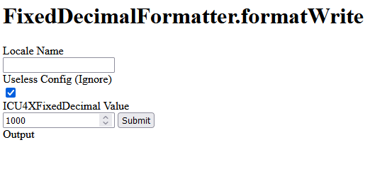
Object Schema
Provide metadata for generated JS functions
export const RenderInfo = {
"FixedDecimalFormatter.formatWrite": {
func: FixedDecimalFormatterDemo.formatWrite,
funcName: "FixedDecimalFormatter.formatWrite",
parameters: [
{
name: "Locale Name",
type: "string"
},
// ...
]
},
};

Slide 22
Automagic HTML!
#[diplomat::bridge]
Bindings

Slide 23

Open to contributions!
Looking for users!
This could be YOU
…and your Rust library
Always looking for contributors to expand on our backends!

Slide 24
The End
Thank you to:
Shane Carr
Manish Goregaokar
Robert Bastian
Elango Cheran
Organizers of UTW 2024
And YOU!

Slide 25
Questions?

Slide 26
Outline
What is Diplomat? (5 minutes)
  History/Problem Statement
    Sample problem: ICU4X, porting Rust library to many languages
  Solution Statement: Diplomat
Diplomat’s design (7 minutes)
  No action-at-a-distance
    “What you see is what you mean”
  Ready to use
  Uses Rust for definition
    No IDLs
    Seamless Integration of API and code
    Easily extensible
  Should pepper with some visual examples (how a bridge gets converted to C, JS, etc.)
Generating Web Demos Automatically (10 minutes)
  Live Demo
  How the demo (roughly) works
    Diplomat’s design allows us to do this naturally
    Diagrams!
  Current challenges
Call to action (3 minutes)
  What we’re working on for the future

Slide 27
Notes
Notes:
Like the abstract, but with more of a focus on demo_gen and what you did over summer
Audience:
Mostly technical
Look at lineup online?
Interest in Rust is not as high
People do not really understand Rust specifically
(or Web Assembly)
Know languages, computers, etc.
Look at big picture down, focus on the abstract of how things work, not really their specifics.
40 minutes total, 25-30 minutes for presenting, 10-15 minutes for questions

