Slide 1
The Unicode Standard and the Unicode Approval Process
MWG/3-N6
Deborah anderson, Script encoding initiative, UC Berkeley
Ulaanbaatar, Mongolia April 3-5, 2019

Slide 2
Background on the Unicode Standard
Makes it possible so
text and documents are interchangeable
platforms supporting Mongolian are interoperable
You want what you type to be received correctly:

Slide 3
Background on the Unicode Standard
What users don’t want…
You type: Users get instead:

Slide 4
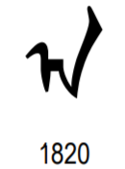
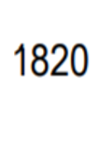
Unicode Basics
Unicode assigns a number (“code point”) to the letters and symbols in a script. It also includes a representative glyph and name.
Glyph
Code point
MONGOLIAN LETTER A Name

Slide 5
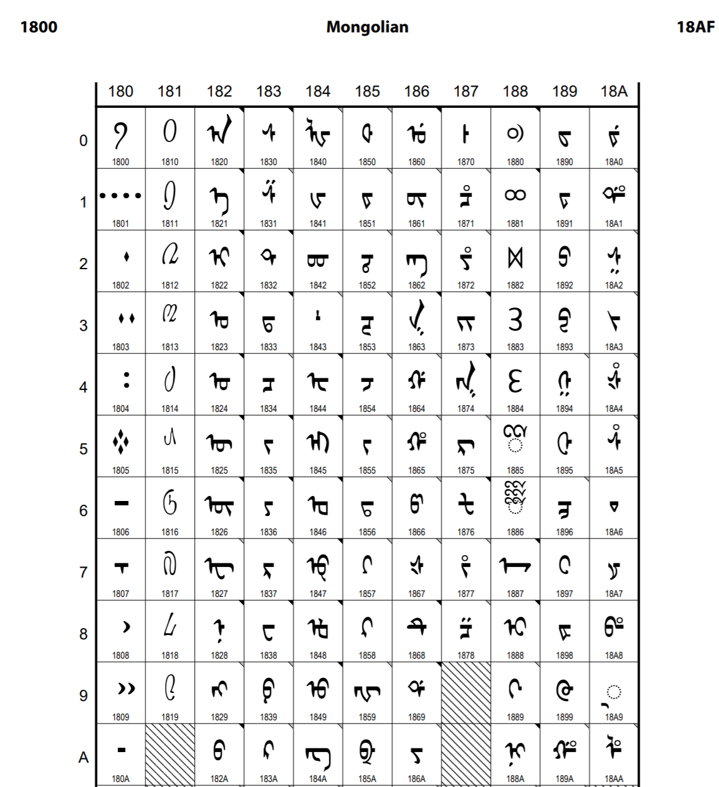
Unicode Basics
Code chart
https://www.unicode.org/charts/PDF/U1800.pdf
Notes:
The Mongolian code chart is at: https://www.unicode.org/charts/PDF/U1800.pdf
The Mongolian Supplement chart, which includes additional characters, is found at: https://www.unicode.org/charts/PDF/U11660.pdf

Slide 6
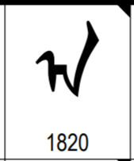
Unicode Basics
Code chart
https://www.unicode.org/charts/PDF/U1800.pdf
Notes:
The Mongolian code chart is at: https://www.unicode.org/charts/PDF/U1800.pdf
The Mongolian Supplement chart, which includes additional characters, is found at: https://www.unicode.org/charts/PDF/U11660.pdf

Slide 7
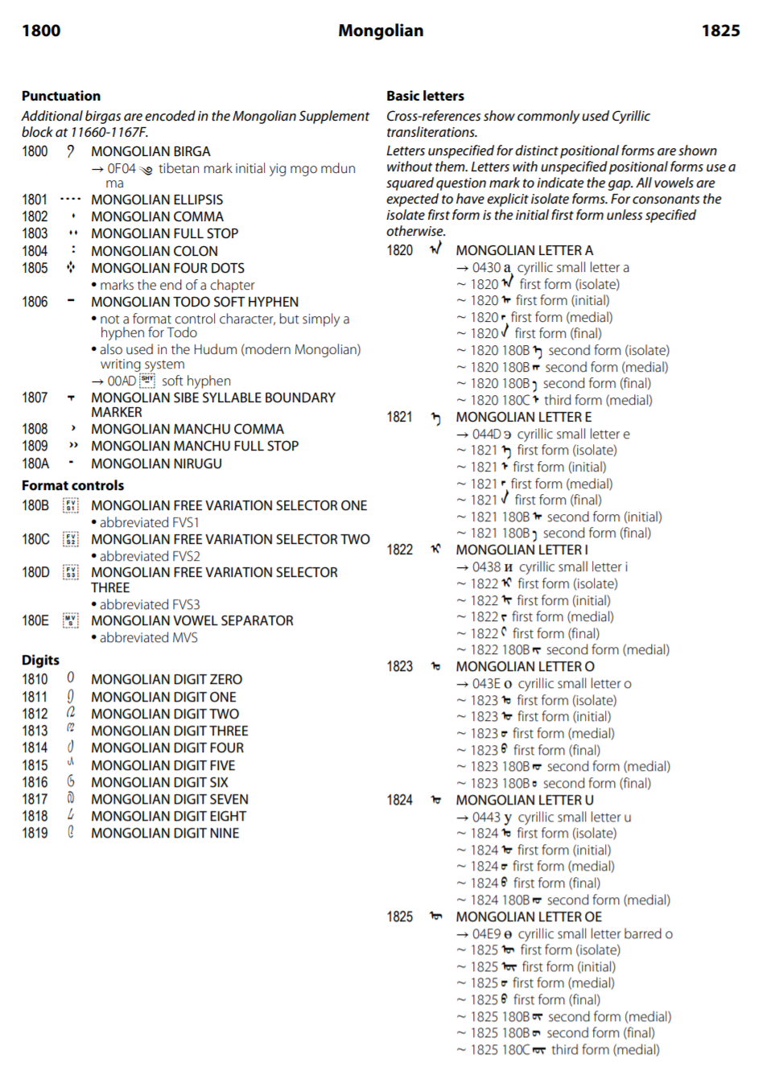
Unicode Basics
Names list

Slide 8
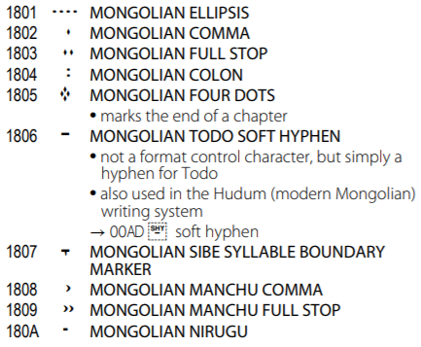
Unicode Basics
Names list

Slide 9
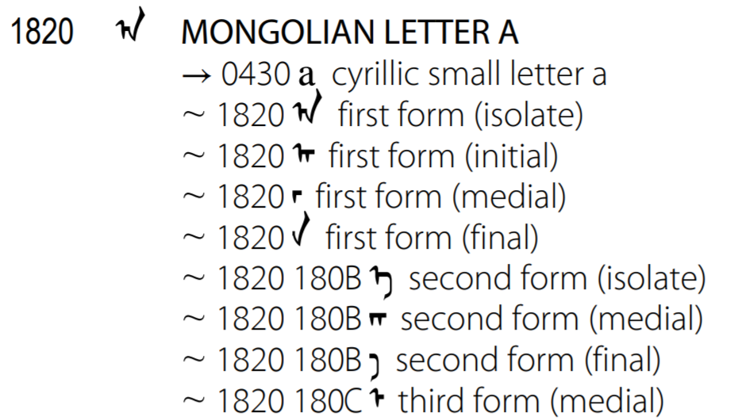
Unicode Basics
Names list
Including variant information in names list poses problems:
Not the usual approach
Can’t capture all the details of writing system
Hard to maintain
Recommend a different approach

Slide 10
Unicode Basics
Names list
Separate from Unicode publication and its publishing cycle
Easy to edit
Contents could become a Unicode Technical Standard, after community agreement
https://unicode.org/notes/

Slide 11
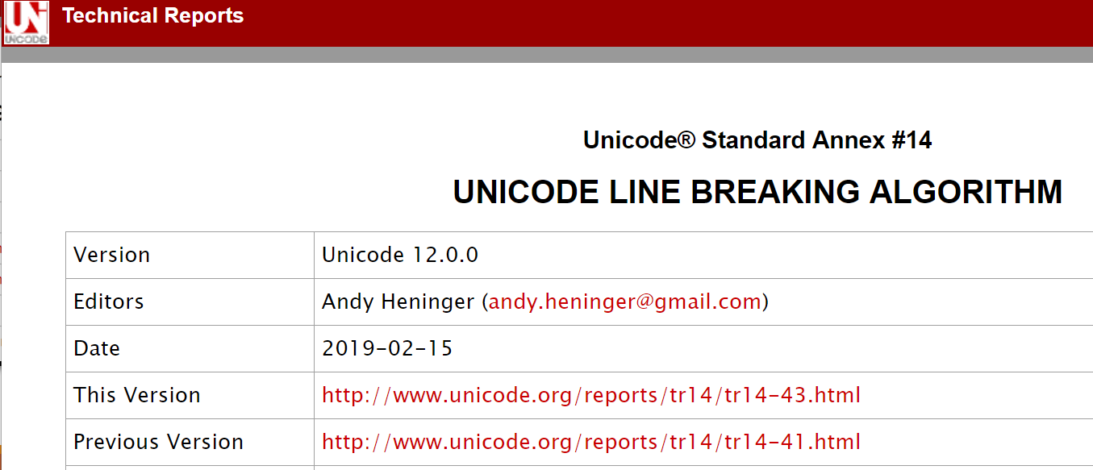
Unicode Basics
The Unicode Standard also includes information on characters’ behavioral properties (such as line breaking, text segmentation, etc.)
https://www.unicode.org/reports/tr14/

Slide 12
Character Approval and Support Process

Slide 13
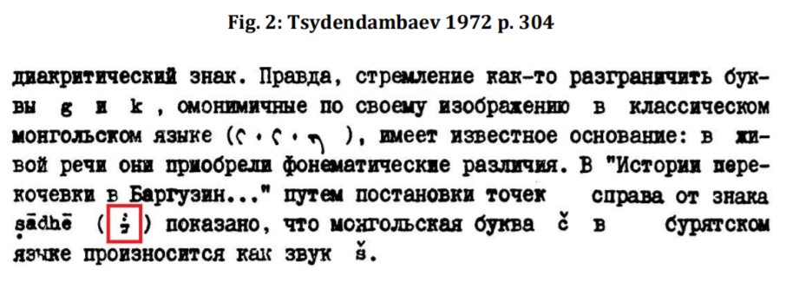
Character Approval Process
Preparation of proposal
Example from a 2017 proposal to add one character:
MONGOLIAN LETER CHA WITH TWO DOTS
Note that proposals should include evidence:
https://www.unicode.org/L2/L2017/17007-n4781-mongolian.pdf
Notes:
Buryat letter: 1878 MONGOLIAN LETTER CHA WITH TWO DOTS, see https://www.unicode.org/L2/L2017/17007-n4781-mongolian.pdf

Slide 14
Character Approval Process
Preparation of proposal
Review by Unicode Script Ad Hoc
Reviews proposals and makes recommendations to standards committees

Slide 15
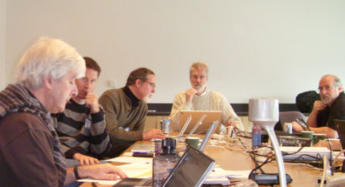
Character Approval Process
Preparation of proposal
Review by Unicode Script Ad Hoc
Unicode Technical Committee
Reviews proposals and makes decisions on proposals
Notes:
The UTC meets 4x a year and includes representatives from companies, universities, countries, and other groups. Lisa Moore is Chair.

Slide 16
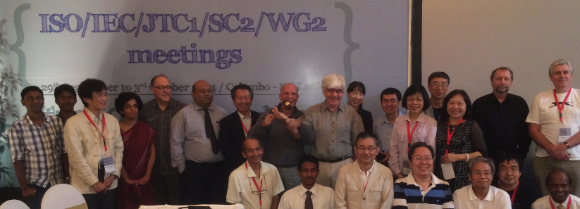
Character Approval Process
Preparation of proposal
Review by Script Ad Hoc
Unicode Technical Committee ISO SC2/WG2
Reviews proposals and decides whether to put on ballot
Notes:
Meets 1x per year
Reviews documents and decides if to put proposed characters on a ballot
Ballots are voted on by National Bodies (Mongolia: MASM, China: SAC, US: ANSI)
Several rounds of ballots before approval and publication

Slide 17
Character Approval Process
Preparation of proposal
Review by Script Ad Hoc
Unicode Technical Committee ISO SC2/WG2
Notes:
The Unicode Standard is published yearly, with release dates in March.
The ISO/IEC 10646 publishes less often.

Slide 18
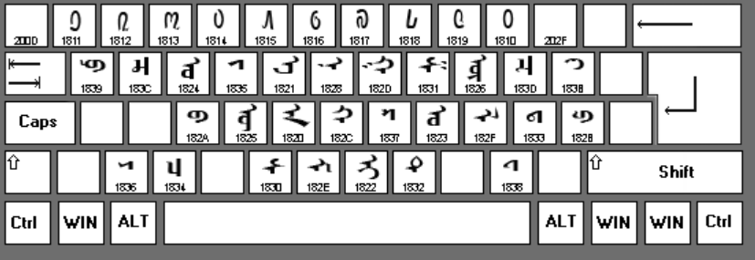
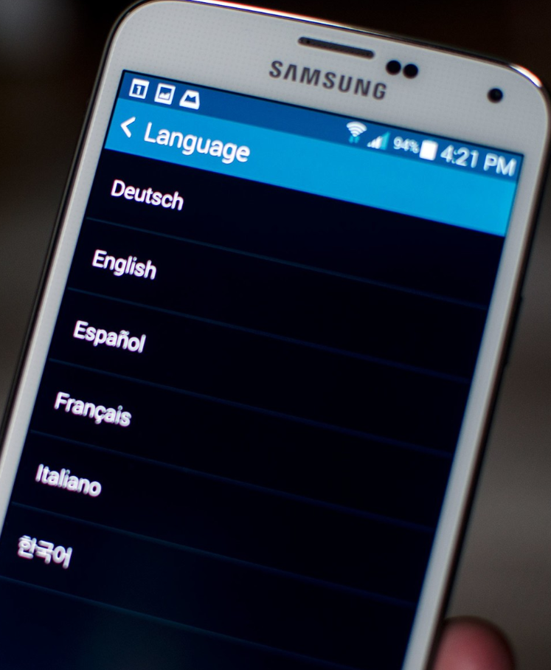
Character Support Process
After publication need: Fonts and keyboard definition
Locale data

Slide 19
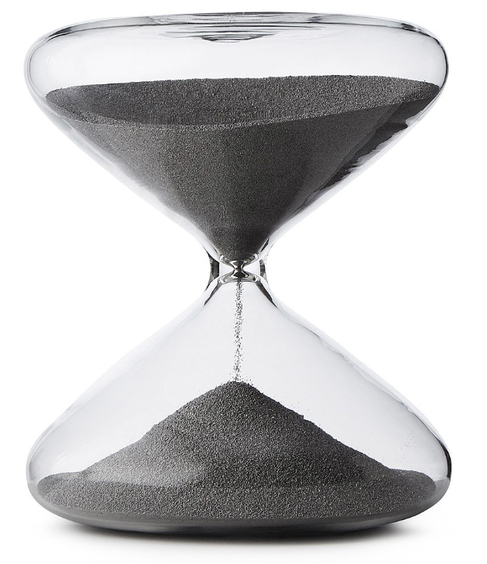
Character Approval and Support Process - Summary
Many steps are involved in getting characters approved
Can take several years for characters to be approved and implemented on devices
Working together helps the process go smoothly

Slide 20
Character Approval and Support Process - Summary
Many steps involved in getting characters approved
Can take several years for characters to be approved and implemented on devices
Working together helps the process go smoothly
Баярлалаа!

